Slide 1
International Partnership for
Nuclear Disarmament
Verification
U.N. First Committee
October 6, 2017

Slide 2
Initial Focus
When launching the IPNDV, the Partners agreed that we should assess monitoring and verification issues across the nuclear weapons lifecycle.
Phase I (2015-2017) has focused on monitoring and verification activities associated with the dismantlement of nuclear weapons – one of the most important and complex issues related to future arms control reductions.
The Terms of Reference for the Working Groups defined a set of deliverables to be presented at the end of Phase I.

Slide 3
Working Groups
The Working Groups are focused on:
1. Monitoring and Verification Objectives, co-chaired by The Netherlands and the United Kingdom;
2. On-Site Inspections, co-chaired by Australia and Poland; and
3. Technical Challenges and Solutions, co-chaired by Sweden and the United States.

Slide 4
Working Groups

Slide 5
Progress Report

Slide 6
Concluding Phase I
The following documents will be released at the Buenos Aires Plenary in November:
The deliverables produced by the three Working Groups;
Technology data sheets that supported the work of Working Group 3;
A report highlighting the IPNDV Walkthrough Exercise that took place in June 2017;

Slide 7
Concluding Phase I
A report summarizing the work accomplished by the Partnership during Phase I. The report will provide more information on:
The history and scope of work of Phase I
How the Partnership is addressing the challenges and identifying solutions associated with the verification of nuclear disarmament
The Working Groups’ key findings
Recommendations for a Work Program for Phase II

Slide 8
Concluding Phase I
In addition NTI, with a financial contribution from Canada, will be releasing:
A new standalone IPNDV website; and
An informative infographic representing the basic dismantlement scenario of Phase I.

Slide 9
Launching Phase II
Phase II of the IPNDV will be launched at the Buenos Aires Plenary in November 2017.
It will assess in greater detail, and explore, some of the nuclear weapon dismantlement monitoring and verification technologies and procedures identified in Phase I.
Phase II will also extend its focus beyond the dismantlement of nuclear weapons and address verification issues across the wider nuclear disarmament process.

Slide 10
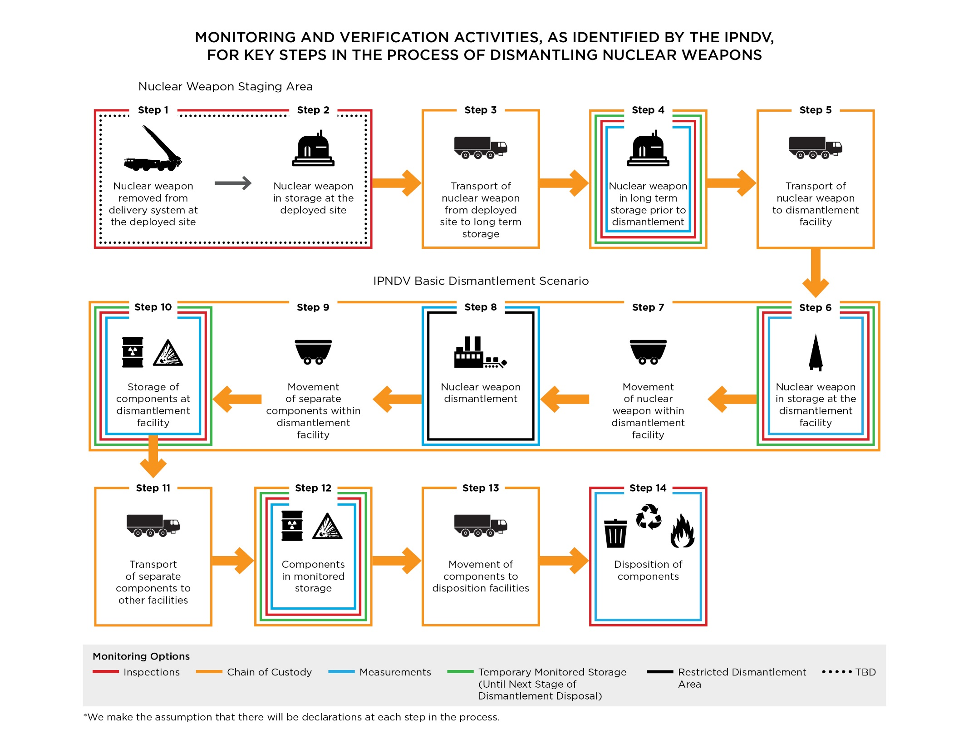

Slide 11
International Partnership for Nuclear Disarmament Verification
Learn more at:
www.nti.org/about/projects/international-partnership-nuclear-disarmament-verification/

