Slide 1
International Partnership for
Nuclear Disarmament
Verification
Looking toward Phase II – Facilitated Discussion

Slide 2
Purpose and format
Take a “quick look ahead” at some of the questions and issues of the three new Working Groups
“Correctness and Completeness”, “Dismantlement and Disposition”, and “Tools and Technologies”
With a focus on insights from Phase I for the work of the new Groups as we begin Phase II
Each new Working Group in turn, then cross-cutting lessons
With questions to foster discussion – in “baskets” of issues
Everyone also should raise other insights or lessons
More questions than likely to be able to discuss
Jump-start thinking for the new Working Groups but not prejudge how they define their own program of work

Slide 3
Working Group 4 – “Correctness and Completeness”
Focus on how to verify correctness and completeness of declarations of nuclear weapons under an Agreement, including, for example:
Confirm items are as declared
Confirm number of nuclear weapons, including when access not timely
Track numbers over many years
Types of declarations, documentation, and supporting information as part of inspection and monitoring of nuclear disarmament
Develop specific verification options for different locations and scenarios

Slide 4
Working Group 4 – Some questions for discussion in light of Phase I (1)
What specific issues and questions should be addressed first by this Working Group?
What is the set of declarations of nuclear weapons that should be examined in greater detail? Why?
Total number? Number for elimination under a specific Agreement? Number in storage, transit, undergoing dismantlement? Number dismantled? All of above?
Are there trade-offs or constraints that impact declarations and should be explored more fully in Phase II?

Slide 5
Working Group 4 – Some questions for discussion in light of Phase I (2)
What on-site inspection procedures (vice technologies) identified in Phase I may warrant additional focus for confirming items are as declared?
What other “types of declarations, documentation, and supporting information” should be explored to support inspection and monitoring for nuclear disarmament? To confirm items are as declared?
Declarations of sites, activities, flows across the nuclear-weapon life-cycle?
Access to documentation and records – of what sort?

Slide 6
Working Group 4 – Some questions for discussion in light of Phase I (3)
Are there other declarations possibly to consider prior to the steps of the 14-step framework?
Production? Depiction of the full nuclear-weapon life cycle?
As depicted by NTI life-cycle graphic on next slide
Should the Working Group also consider the contribution of voluntary transparency measures and reporting?
Other voluntary declarations that would support a future agreement for nuclear disarmament verification?

Slide 7
Materials Production
Weapons Assembly
Weapons Stockpile
Weapons Disassembly
Storage
Disposition
Uranium mining
Uranium processing
U
ra
a
ni
u
m
HEU
Disposition
r
n
U
i
u
m
Natural uranium
Highly Enriched Uranium
Enrichment
Military use
HEU weapons component
LEU
HEU
Strategic Reserve
Natural or LEU
Parts fabrication
Weapons stockpile
U
r
a
n
HEU
Component Storage
i
Fuel fabrication
u
m
Fuel fabrication
Naval fuel storage
Civilian reactors
Assembly
Warhead storage/ staging
De-Mated warhead storage
Disassembly
Spent
Pre-1997
u
m
i
n
o
t
u
Military use
l
Pu Component Storage
Pu Strategic Reserve
P
Reprocessing
Post-1997, naval fuel, commercial
Pu parts fabrication
Plutonium production reactors
o
ni
u
m
Pre-1997, weapons-grade
Pu weapons component
P
t
Bilateral Reductions (New START)
l
u
u
Pl
t
o
n
i
Plutonium Production Reactor Agreement (PPRA)
u
m
Joint Comprehensive Plan of Action (JCPOA)
Pu Disposition
IPNDV Phase I (2015–2017)
IPNDV Phase II (2018-2019)
Reprocessing
Nuclear Weapons Lifecycle Monitoring through Cooperative Initiatives
October 2017

Slide 8
Working Group 4 – Some questions for discussion in light of Phase I (4)
What other insights are there from Phase I for the activities of Working Group 4?

Slide 9
Working Group 5 – “Dismantlement and Disposition”
Focus on verifying the reduction of a declared number of nuclear weapons, including, for example:
Significant number of weapons from deployment to disposition across the 14-steps
Considering the process as a whole – and how to build confidence across in the overall elimination process, over time
Develop monitoring and verification options, including consideration of potential trade-offs
Practicality, intrusiveness, proliferation risk, effectiveness, and necessity
In parallel with Working Group 4, address question of confirming declared items are nuclear weapons – with any further methods or supporting information

Slide 10
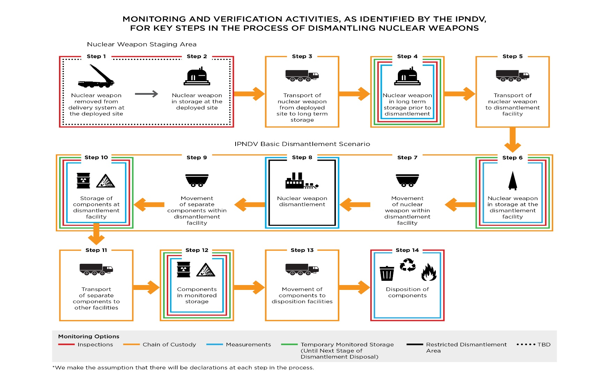
Nuclear weapon dismantlement

Slide 11
Working Group 5 – Some questions for discussion in light of Phase I (1)
What specific issues and questions should be addressed first by this Working Group?
How could the assumption of monitoring a significant number of weapons going from deployment to disposition, over a long period of time, impact the process?
Looking at all of the steps, are there findings from Phase I Basic Dismantlement Scenario could carry over to other steps – and could be part of the initial focus?
Already identified chain of custody, measurements, and technologies and tools? On-site inspection procedures?

Slide 12
Working Group 5 – Some questions for discussion in light of Phase I (2)
By following the overall 14-step process, what types of lessons could be learned for specific steps?
For example, could inspection and monitoring methods and supporting information in the earlier steps reinforce inspection and monitoring in the Basic Dismantlement Scenario?
What trade-offs stand out from Phase I as the most important to focus on initially?
Among practicality, intrusiveness, proliferation risk, effectiveness, and necessity

Slide 13
Working Group 5 – Some questions for discussion in light of Phase I (3)
Given that both Working Group 4 and Working Group 5 will address the question of confirming that an item is a nuclear weapon, how can they best cooperate?
Co-chair interaction?
Ad hoc joint team on “methods and supporting information“?
Some Working Group members participate in each other’s discussion of this issue?
Shared analytic work – in early drafting?
Joint meetings?

Slide 14
Working Group 5 – Some questions for discussion in light of Phase I (4)
What other insights are there from Phase I for the activities of Working Group 5?

Slide 15
Working Group 6 – “Tools and Technologies”
Identify and advance a limited number of key verification technologies given:
Gaps identified in Phase I regarding detection and monitoring of a nuclear weapon and key components
Importance of development of information barriers and exploring nuclear weapon templates
Together with Working Groups 4 and 5, analyze how technologies can be trusted by both parties (authentication), including meeting safety and security requirements in nuclear explosives facilities (certification)
Undertake technology developments and demonstrations, where practical

Slide 16
Working Group 6 – Some questions for discussion in light of Phase I (1)
What specific issues and questions should be addressed first by this Working Group?
What priorities stand out for advancing key verification technologies?
Areas to reengineer existing technologies?
Most important gaps?
Key enablers?
Long-poles in the tent?
Where can inspection and monitoring procedures reinforce or enable technology options? Provide added “context”?

Slide 17
Working Group 6 – Some questions for discussion in light of Phase I (2)
What possible priorities stand out for any future technology developments and demonstrations?
What metrics could be used to choose a given technology demonstration?
Ripeness? Importance? Hi-payoff learning? Lend self to multi-nation cooperation? Demonstration of actionable results? Other?
Is there a role for coordination among the Working Groups in choosing such demonstrations?
Who could be the participants in such a demonstration? The audience?

Slide 18
Working Group 6 – Some questions for discussion in light of Phase I (3)
Would it be possible to develop a technology development road map? What? Phasing? How?
What could be the pluses and minuses of seeking to do so?
As a lesser step, what about setting out the full “tool kit”? With cross-references to different steps or broader activities?
Given that both Working Group 5 and Working Group 6 will address technologies “authentication” and “certification” how can they best cooperate?
More broadly, how we best integrate technology experts from this Working Group into the work of the other Working Groups – and vice versa?

Slide 19
Working Group 6 – Some questions for discussion in light of Phase I (4)
What other insights are there from Phase I for the activities of Working Group 6?

Slide 20
Cross-cutting insights and lessons for Phase II Working Groups (1)
Are there lessons from Phase I for how to maximize the efficiency and productivity of the Working Groups?
What innovative approaches should be pursued by different Working Groups?
Table-top exercises, simulations, field exercises and trials, engagement with outside experts

Slide 21
Cross-cutting insights and lessons for Phase II Working Groups (2)
How can the Working Groups work more effectively together? Better address issues between them?
What can be done to strengthen coordination and information sharing?
How can we integrate persons from one Working Group in the work of other Working Groups?
Discussed already with the specific Working Groups – but what else might be done?
Are there ways to leverage better the Partnership's diverse membership and expertise to advance Working Group goals?

Slide 22
Cross-cutting insights and lessons for Phase II Working Groups (3)
Going forward, how can we convey most effectively the results of Phase I to others – your senior policy levels, overall governments, publics, NGOs, other entities?
Going forward, how can we convey most effectively the work and emerging tentative results of Phase II?
Periodic briefings at events in the upcoming NPT Review process?
Interaction with the UN Group of Government Experts?
Updates of the Partnership portal?
Development of a rolling Partnership “Nuclear Disarmament Verification Scorecard” – requirements v. monitoring and inspection options v. status?

Slide 23
Wrap-up – and concluding thoughts for new Working Groups
OK – any closing thoughts on “What should the three new Working Groups take from Phase I?”

