Slide 1
International Partnership for
Nuclear Disarmament
Verification
Phase I Results and Policy Issues – Facilitated Discussion

Slide 2
Purpose and format of the facilitated discussion
Dual purpose:
Integrated summary of results of Phase I
Explore together some judgments, issues, and choices arising out of Phase I – and looking to Phase II
Format:
Set out results – and some challenges ahead
With facilitated discussion of key policy judgments, issues, and choices – “along the way”
Close with discussion of some overarching policy choices
Everyone should join the discussion

Slide 3
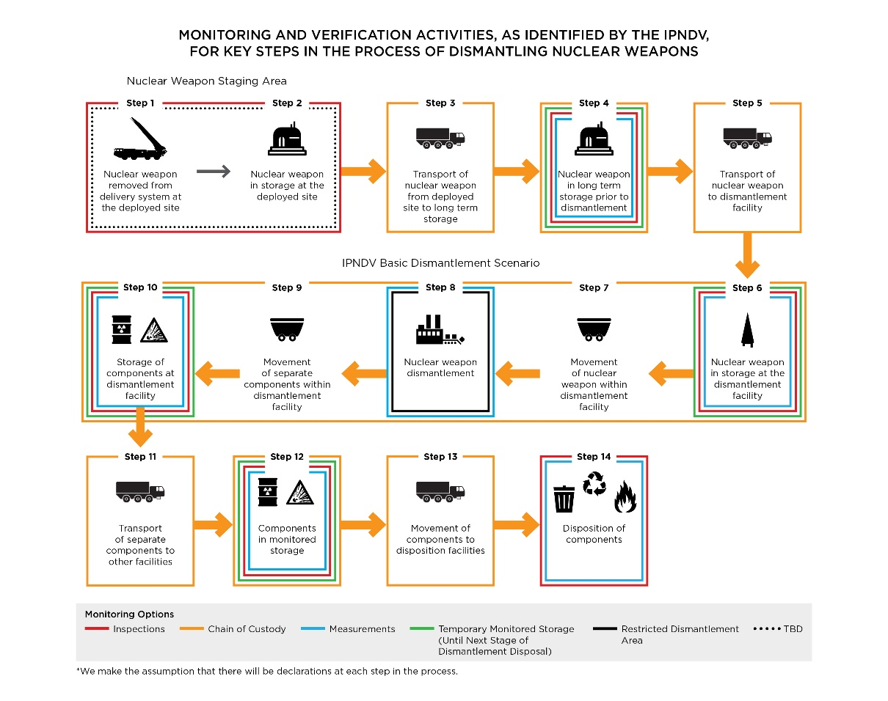
Overall dismantlement framework developed during Phase One
From removal of nuclear weapon subject to inspection and monitored dismantlement to disposition of components
Nuclear weapon in a sealed container – no direct visual observation
Dismantlement defined as separation of Special Nuclear Material (SNM) and High Explosives (HE)
Multiple inspection and monitoring options

Slide 4
Phase I Primary Focus -- Basic Dismantlement Scenario
What: Monitoring and inspection options for steps of actual physical dismantlement of a nuclear weapon
Why: Most important, complex, and technically challenging aspect of nuclear disarmament verification
Confidence in dismantlement essential for future nuclear reductions and disarmament that involves weapons not delivery systems
With: Requires balancing two fundamental goals: building verification confidence and protecting proliferation-sensitive and other classified information as well as meeting safety and security requirements

Slide 5
Some policy issues for discussion
Aside from dismantlement, what other nuclear disarmament verification steps are very important – and should be a focus of the Partnership?
What considerations should be taken into account in determining “essential” steps?
“Initialization” of the nuclear dismantlement process – first confirming presence of a nuclear weapon? Developing knowledge for nuclear disarmament process?
Is confidence in actual nuclear dismantlement essential for nuclear disarmament? Why?

Slide 6
Phase I Key Judgment
While tough challenges remain, potentially applicable technologies, information barriers, and inspection procedures provide a path forward that should make possible multilaterally monitored nuclear warhead dismantlement while successfully managing safety, security, non-proliferation, and classification concerns in a future nuclear disarmament agreement

Slide 7
Four conclusions underlying the key judgment
Inspection technologies exist or can be implemented to ensure chain of custody in the dismantlement process
Multiple technology options exist to permit measurement for SNM in sealed containers – within certain technical constraints, with information barriers
Technologies can be identified to show possible presence of HE in sealed containers
Inspection technologies exist or can be implemented to ensure integrity of areas of the dismantlement process
Let’s now explore the basis of these conclusions by walking through the dismantlement process – and some outstanding policy assumptions, uncertainties, and choices

Slide 8
Begin with “Nuclear weapon in storage at dismantlement facility”

Slide 9
Nuclear weapon in temporary storage at Dismantlement Facility (1) – Chain of custody
Step: Nuclear weapon in temporary storage prior to being dismantled under a future disarmament agreement (Step 6a)
Monitoring and inspection tasks | Technologies and procedures
Confirm and apply chain of custody technologies and procedures – for container in temporary storage, for onward inspection process Ensure integrity of storage area – for confidence in no unauthorized removal or tampering with area | Use of unique identifiers, tags, and seals on containerized nuclear weapon Check agreed inspected state declarations, documentation, and records Inspections and use of containment and surveillance, and portal monitoring technologies

Slide 10
Nuclear weapon in temporary storage at Dismantlement Facility (2) –Initial measurements
Step: Nuclear weapon in temporary storage prior to being dismantled under a future disarmament agreement (Step 6b)
Monitoring and inspection tasks | Technologies and procedures
Confirm containerized item is a nuclear weapon – no direct visual observation of nuclear weapon given need to protect proliferation-sensitive and other information and safety-security Measure for presence of SNM and HE – within agreed parameters Other complementary inspection activities | Multiple technology options Less technically challenging for Plutonium than Uranium; for SNM than for HE Use of information barrier essential – promising concepts, more work to do Physical measurements of container may be an option Possible development and use of nuclear weapon templates – think of as a technical snapshot

Slide 11
Nuclear weapon templates – a quick look
What: measure specific aspects or characteristics of a nuclear weapon in its container = in effect, a “technical snapshot” of the weapon and its components, used with an information barrier
Multiple potential payoffs for building verification confidence
From reduced uncertainty in confirming presence of nuclear weapon/SNM and HE to complementing chain of custody-facility integrity measures
A promising concept – but technical constraints and challenges need to be overcome and more thinking still on applications
Exemplifies Partnership’s contribution in identifying promising nuclear disarmament verification concepts – and will be pursued further in Phase II

Slide 12
Some policy issues for discussion
How can the Partnership best explain to outside audiences why some limits exist on inspector access and how the Partnership developed a credible solution?
Are there other points than Step 6 (Temporary Storage) at which chain of custody could begin?
For example, removal of nuclear weapon from delivery vehicle? Longer-term storage pre-dismantlement?
Would the starting point for chain of custody impact governments’ confidence? Are there operational challenges that need to be considered?
How important is it to measure for the presence of HE – rather than simply for SNM?

Slide 13
Continuing to follow the weapon, “Movement” and “Dismantlement”

Slide 14
Movement of nuclear weapon within facility
Step: containerized nuclear weapon transported from temporary storage to dedicated dismantlement area (Step 7)
For security reasons, no visual observation by inspectors of actual transport of the nuclear weapons Reliance during transport on procedures for chain of custody applied in Step 6a (to be rechecked at Step 8a)
Building verification confidence should be viewed as the result of many separate, mutually-reinforcing, and cumulative activities across the process of dismantlement

Slide 15
Nuclear weapon dismantlement – entry to dedicated area
Step: Nuclear weapon arrives and enters dedicated dismantlement area in preparation for its dismantlement (Step 8a)
Monitoring and inspection tasks | Technologies and procedures
Ensure unbroken chain of custody from temporary storage site Ensure integrity of dismantlement area -- for confidence in no unauthorized removal of nuclear weapon/SNM or HE or tampering with area | Confirm unique identifiers, tags, and seals already on container Check agreed inspected state declarations, documentation, and records Inspections, use of containment and surveillance and portal monitoring technologies Inspect area with radiological/HE detection technologies (for pre-dismantlement baseline )

Slide 16
Nuclear weapon dismantlement – during dismantlement process
Nuclear weapon dismantled by nuclear weapon country in accordance with nuclear disarmament agreement
No direct observation by monitoring and inspection team given the need to protect proliferation-sensitive and other classified information as well as safety and security requirements NOTE: Direct observation will reveal sensitive nuclear weapons design information to inspectors

Slide 17
Nuclear weapon dismantlement – exit from dedicated area (1)
Step: Containers with SNM/HE exit dedicated dismantlement area (Step 8b)
Monitoring and inspection tasks | Technologies and procedures
Ensure unbroken chain of custody – within dedicated dismantlement area, onward to temporary storage Measure exiting SNM/HE containers to confirm presence of SNM/HE Confirm no SNM/HE or weapon remains in dismantlement area – and no unauthorized removal of any containers | Use of unique identifiers, tags, and seals on containers Check agreed inspected state declarations, documentation, and records Portal monitoring technologies for entry-exit Continued on next slide

Slide 18
Nuclear weapon dismantlement – exit from dedicated area (2)
Step: Containers with SNM/HE exit from dismantled nuclear weapon exit dedicated dismantlement area (Step 8b)
Monitoring and inspection tasks | Technologies and procedures
Ensure onward chain of custody – to temporary storage Measure SNM/HE containers to confirm presence of SNM/HE Confirm no SNM/HE or weapon remains in dismantlement area – and no unauthorized removal of any containers | Multiple measurement technologies as in initial arrival Additional techniques may be available – nuclear weapon now dismantled Inspect with radiological/HE detection technologies – ensure no remaining SNM/HE in area Possible development and use of nuclear weapon “templates”

Slide 19
Some policy issues for discussion
In balancing building confidence and protecting proliferation-sensitive and other information as well as ensuring safety and security:
What would strengthen understanding by different audiences of need to balance these considerations?
Would different “stakeholders” emphasize one or the other aspect?
What are the most important factors shaping how the balance should be struck?
How can the Partnership best explain how this balance has been struck, and why?

Slide 20
Following containerized SNM and HE, “Movement” and “Storage”

Slide 21
Movement of nuclear weapon components within facility
Step: containerized nuclear weapon components (SNM and HE) transported from temporary storage to dedicated dismantlement area (Step 9)
For security reasons, no visual observation by inspectors of actual transport of the nuclear weapons Reliance during transport on procedures for chain of custody
Building verification confidence should be viewed as the result of many separate, mutually-reinforcing, and cumulative activities across the process of dismantlement

Slide 22
Temporary storage of SNM/HE (1) – Chain of custody
Step: Containerized SNM/HE placed in temporary storage prior to longer-term monitoring (Step 10a)
Monitoring and inspection tasks | Technologies and procedures
Confirm and apply chain of custody technologies and procedures – for containers arriving from dedicated dismantlement area, for longer-term monitoring, for onward inspection process of final disposition | Use of unique identifiers, tags, and seals on containerized nuclear weapon components Check agreed inspected state declarations, documentation, and records Inspections and use of containment and surveillance, and portal monitoring technologies

Slide 23
Temporary storage of SNM/HE (2) – Longer-term monitoring
Step: Longer-term monitoring of containerized SNM/HE in temporary storage prior to ultimate disposition (Step 10b)
Monitoring and inspection tasks | Technologies and procedures
Confirm chain of custody Ensure integrity of storage area – for confidence in no unauthorized removal of SNM/HE or tampering with area Periodic measurement to re-confirm presence of SNM/HE – until moved in accordance with Agreement | Use of unique identifiers, tags, and seals Check declarations, documentation, and records Use of containment and surveillance, and portal monitoring technologies Multiple measurement technologies as above Ad hoc/routine on-site inspections

Slide 24
Some policy issues for discussion
Do you agree that verification confidence should be viewed as the result of many separate, mutually reinforcing, and cumulative inspection and monitoring activities over time?
Thereby compensating for possible verification uncertainties at any one specific step in the dismantlement process – especially in an ongoing inspection and monitoring process over many years
Given verification uncertainties, what will shape views of how much confidence is enough? Are there other factors outside of the inspection and monitoring regime?
How should the Partnership explain to different audiences this approach to building verification confidence?

Slide 25
Road map ahead – next steps from Phase One
Phase I identified nuclear disarmament verification areas and tasks for additional analysis, including:
Declarations and access by inspectors to documentation and records
Data handling issues
Technology development and technology reengineering priorities
Detailed assessment of nuclear weapon templates
Testing promising technologies and procedures
Strengthening international collaboration, including partnerships of nuclear possessor and non-possessor states and building a verification culture
Addressing the other steps of the 14-step framework

Slide 26
Some overarching policy issues for discussion – looking forward (1)
Going forward, what issues or uncertainties should be priorities to address further in Phase II of the Partnership?
What Partnership activities would most add to its value as seen by Partner governments? Strengthen support for it?
Are there opportunities for bilateral or trilateral cooperation among partners?
How can the Partnership feed into and support the upcoming Group of Government Experts (GGE) on Nuclear Disarmament Verification?

Slide 27
Some overarching policy issues for discussion – looking forward (2)
Is there a need for more outreach to other governments, NGOs, publics? How?
Going forward, how can the Partnership best covey its message and the results achieved?
Can technology demonstrations, exercises, and mock inspections contribute?

Slide 28
Wrap-up
Any concluding questions or comments? What has the Partnership’s work missed, so far?

