Slide 1
THE WAY AHEAD – KEY LESSONS LEARNED AND UNRESOLVED ISSUES
Andrew Bieniawski
Vice President for Material Security and Minimization
January 25, 2018
Wilton Park

Slide 2
Key Lessons Learned
It is essential to first understand the flow and sequence of each step in the disarmament process
U.S.-Russian HEU Purchase Agreement
The verification process should be viewed as the result of many separate, mutually reinforcing, and cumulative activities over time
Providing confidence in the monitoring of nuclear dismantlement requires balancing the need to provide sufficient confidence that a nuclear weapon has been dismantled with:
The need to protect proliferation-sensitive and classified information as well as to meet safety and security requirements.

Slide 3
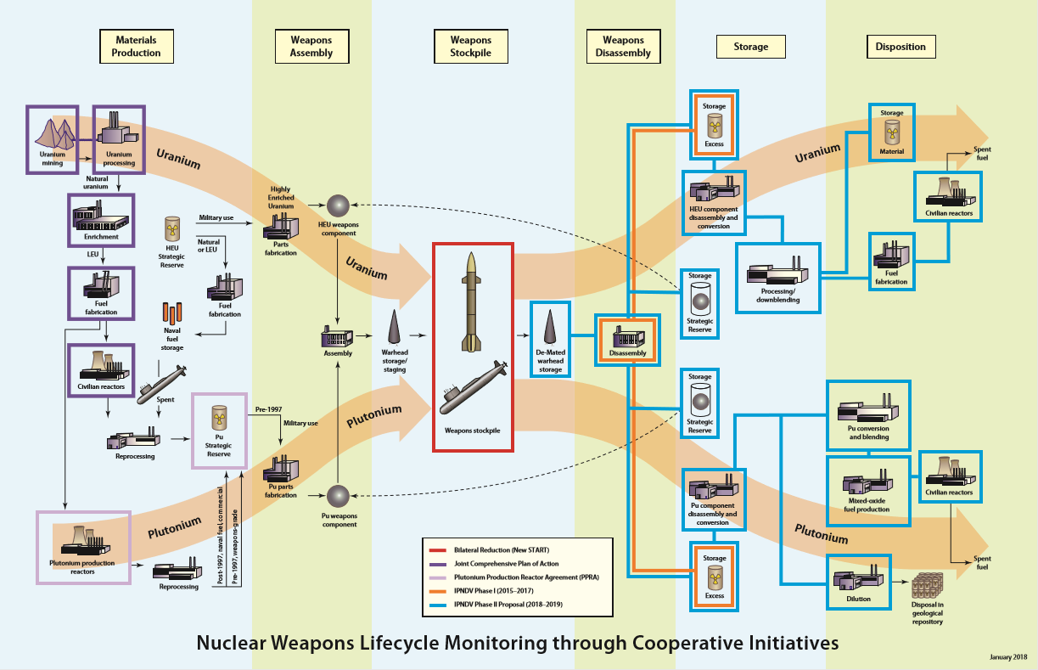

Slide 4
What is already being addressed?
Several initiatives include: UK-Norway, Quad, Trilateral Initiative
IPNDV:
Monitoring nuclear weapon dismantlement – Phase I
Nuclear Weapon Declarations – Phase II
Steps in the process of reducing and eliminating a declared number of nuclear weapons (steps 1-14) – Phase II
From the time a nuclear weapon is removed from a delivery system at the deployment site through dismantlement until disposition of the components

Slide 5
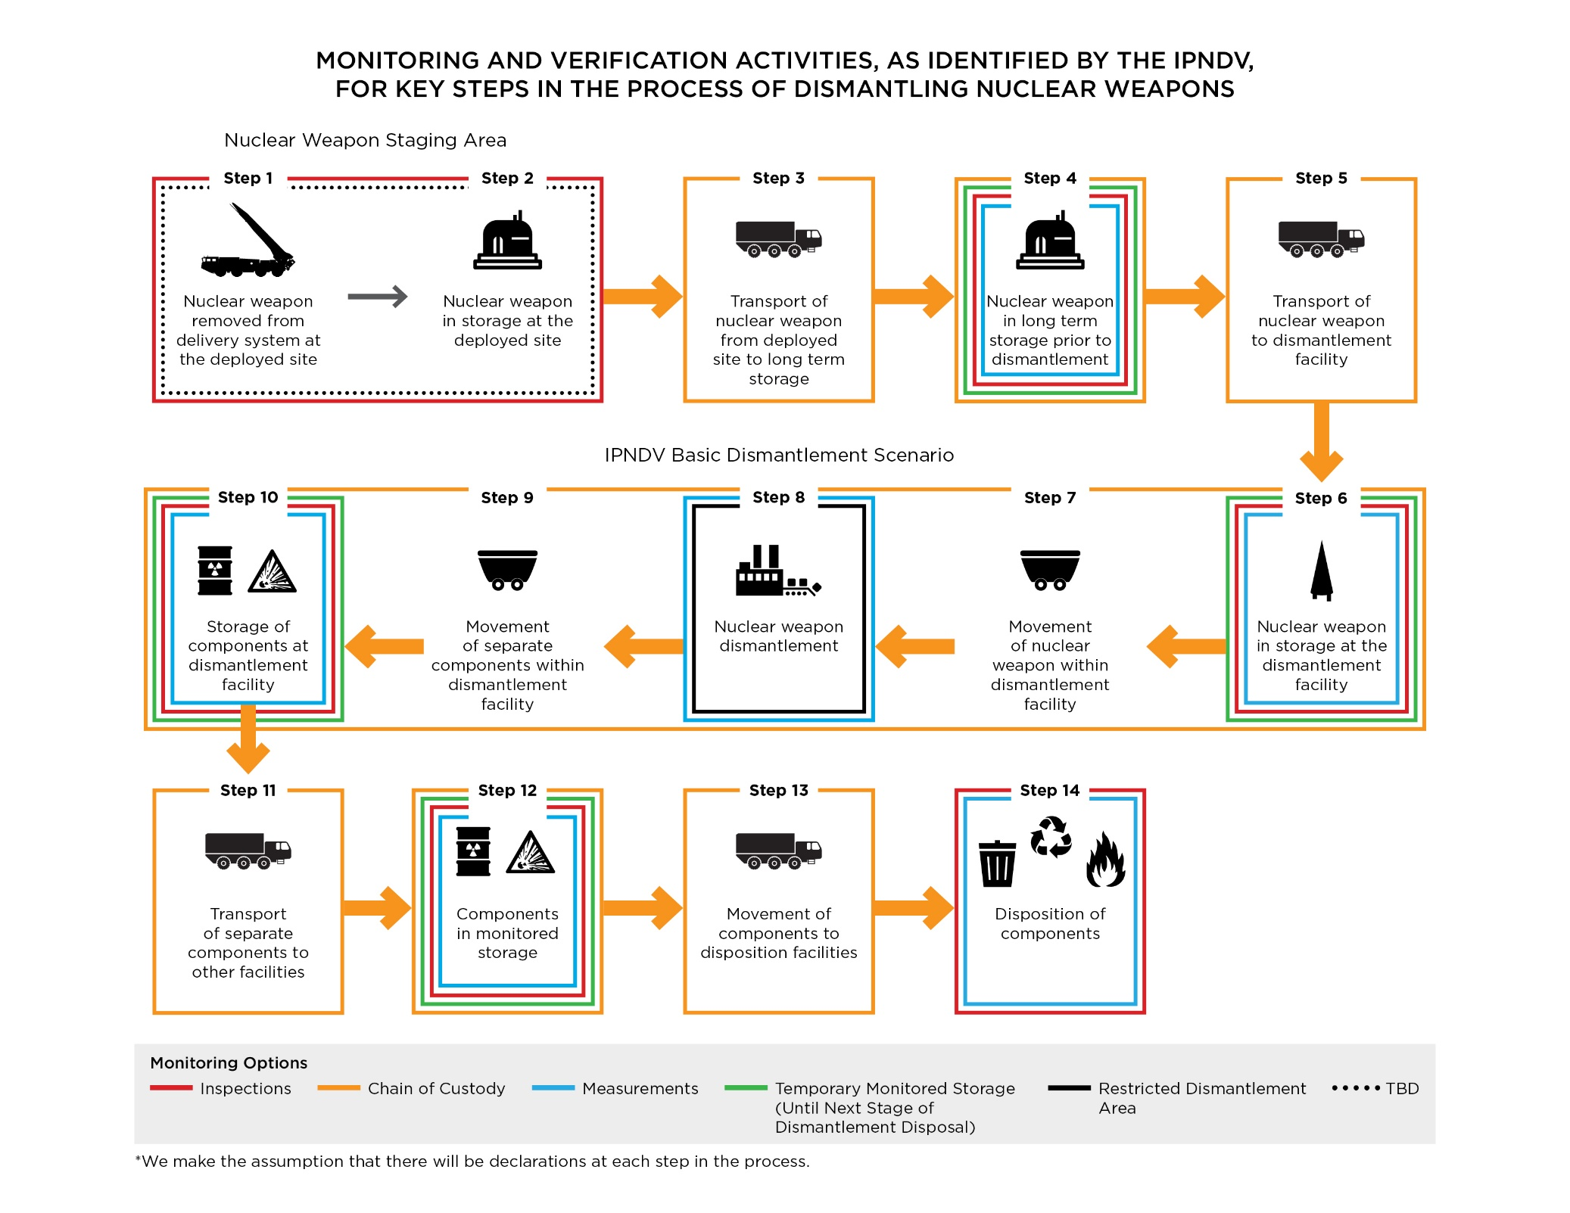

Slide 6
What has yet to be addressed?
Verifying declarations of existing stockpiles/inventories of weapons-usable nuclear material.
Verifying declarations of any new production of weapons-usable nuclear material.
Ensuring the absence of undeclared warheads and weapons-usable nuclear material.

Slide 7
The Way Ahead
A comprehensive approach is needed to address all aspects of nuclear disarmament verification.
IPNDV and other initiatives can provide useful inputs into the GGE – including work carried forward in Phase II.
Give priority in GGE work to most critical uncertainties, gaps, and open issues.
The UN GGE provides a unique opportunity to make concrete recommendations to the UN Secretary General, which could include the establishment of a Group of Scientific Experts.

