Slide 1
Andrew Newman 2019 Nuclear Non-Proliferation Treaty Preparatory Committee Meeting May 7, 2019

Slide 2
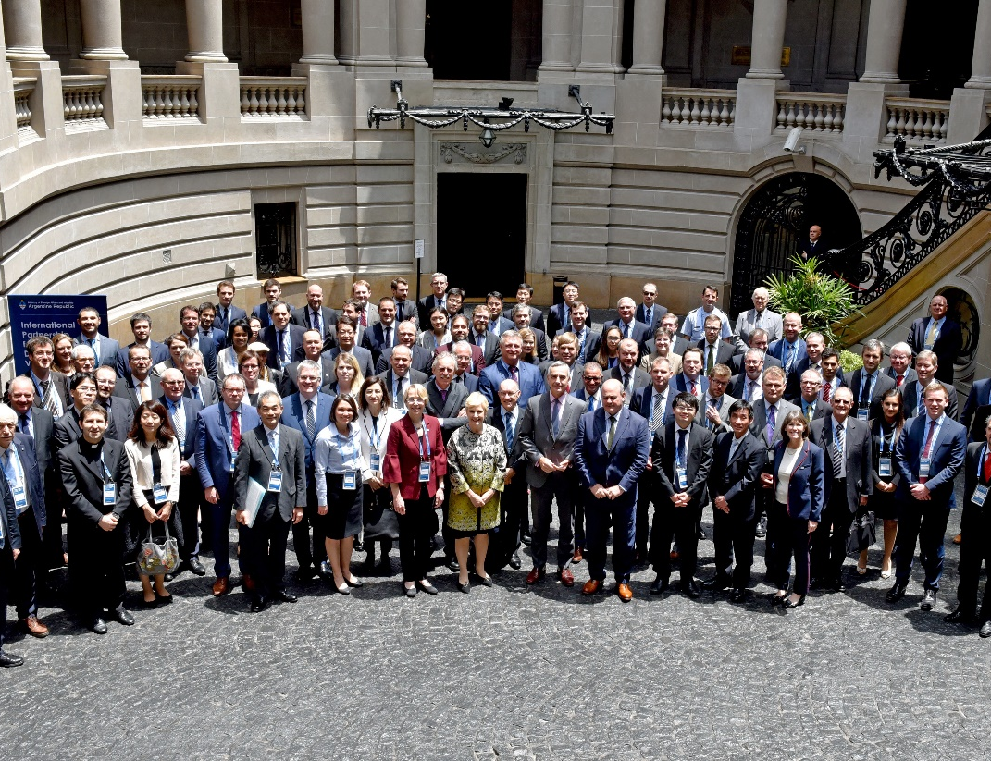
About the IPNDV
More than 25 countries with and without nuclear weapons which are:
Identifying challenges of nuclear disarmament verification
Developing potential solutions to address those challenges
Building and diversifying international capacity and expertise

Slide 3
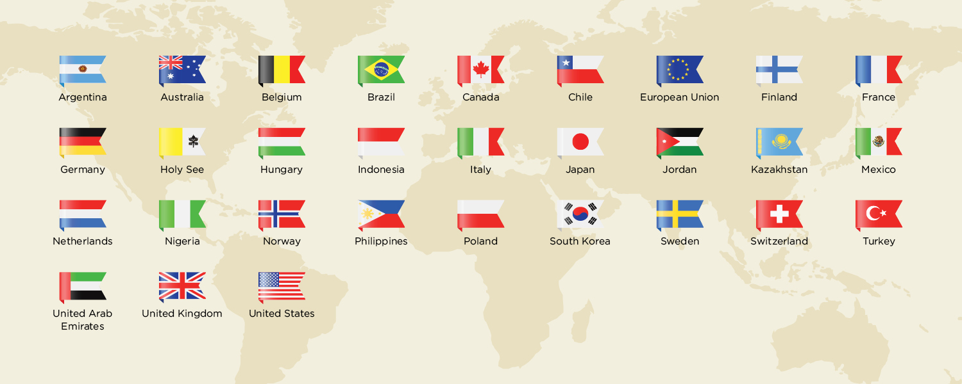
Partners
25+ countries with and without nuclear weapons

Slide 4
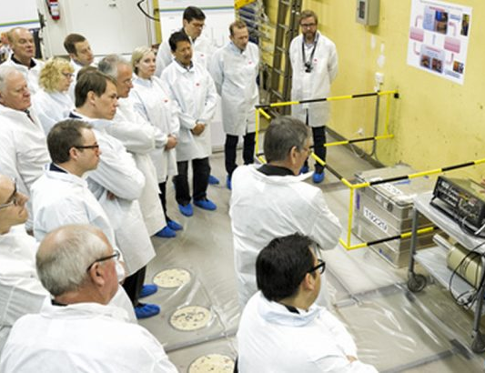
History
Announced in December 2014
Builds on and complements previous verification and monitoring initiatives:
Verification Pilot Project
The U.S.-Russia monitoring and verification experience
The U.S.-UK Program on Nonproliferation and Arms Control Technology
UK-Norway Initiative on Nuclear Warhead Dismantlement Verification

Slide 5
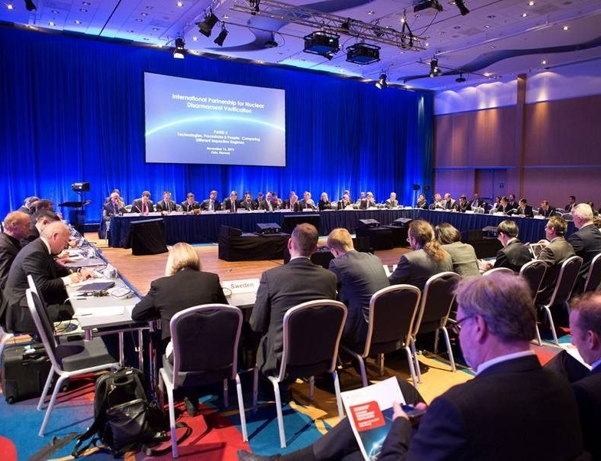
Structure
On-going effort
Three technical working groups that meet several times a year in Joint Working Group meetings and Plenaries
Meetings hosted in partner countries

Slide 6
Working Groups & Phases
Phase I | Phase II
Working Group 1: Monitoring and Verification Objectives | Working Group 4: Verification of Nuclear Weapon Declarations
Working Group 2: On-Site Inspections | Working Group 5: Verification of Reductions
Working Group 3: Technical Challenges and Solutions | Working Group 6: Technologies for Verification

Slide 7
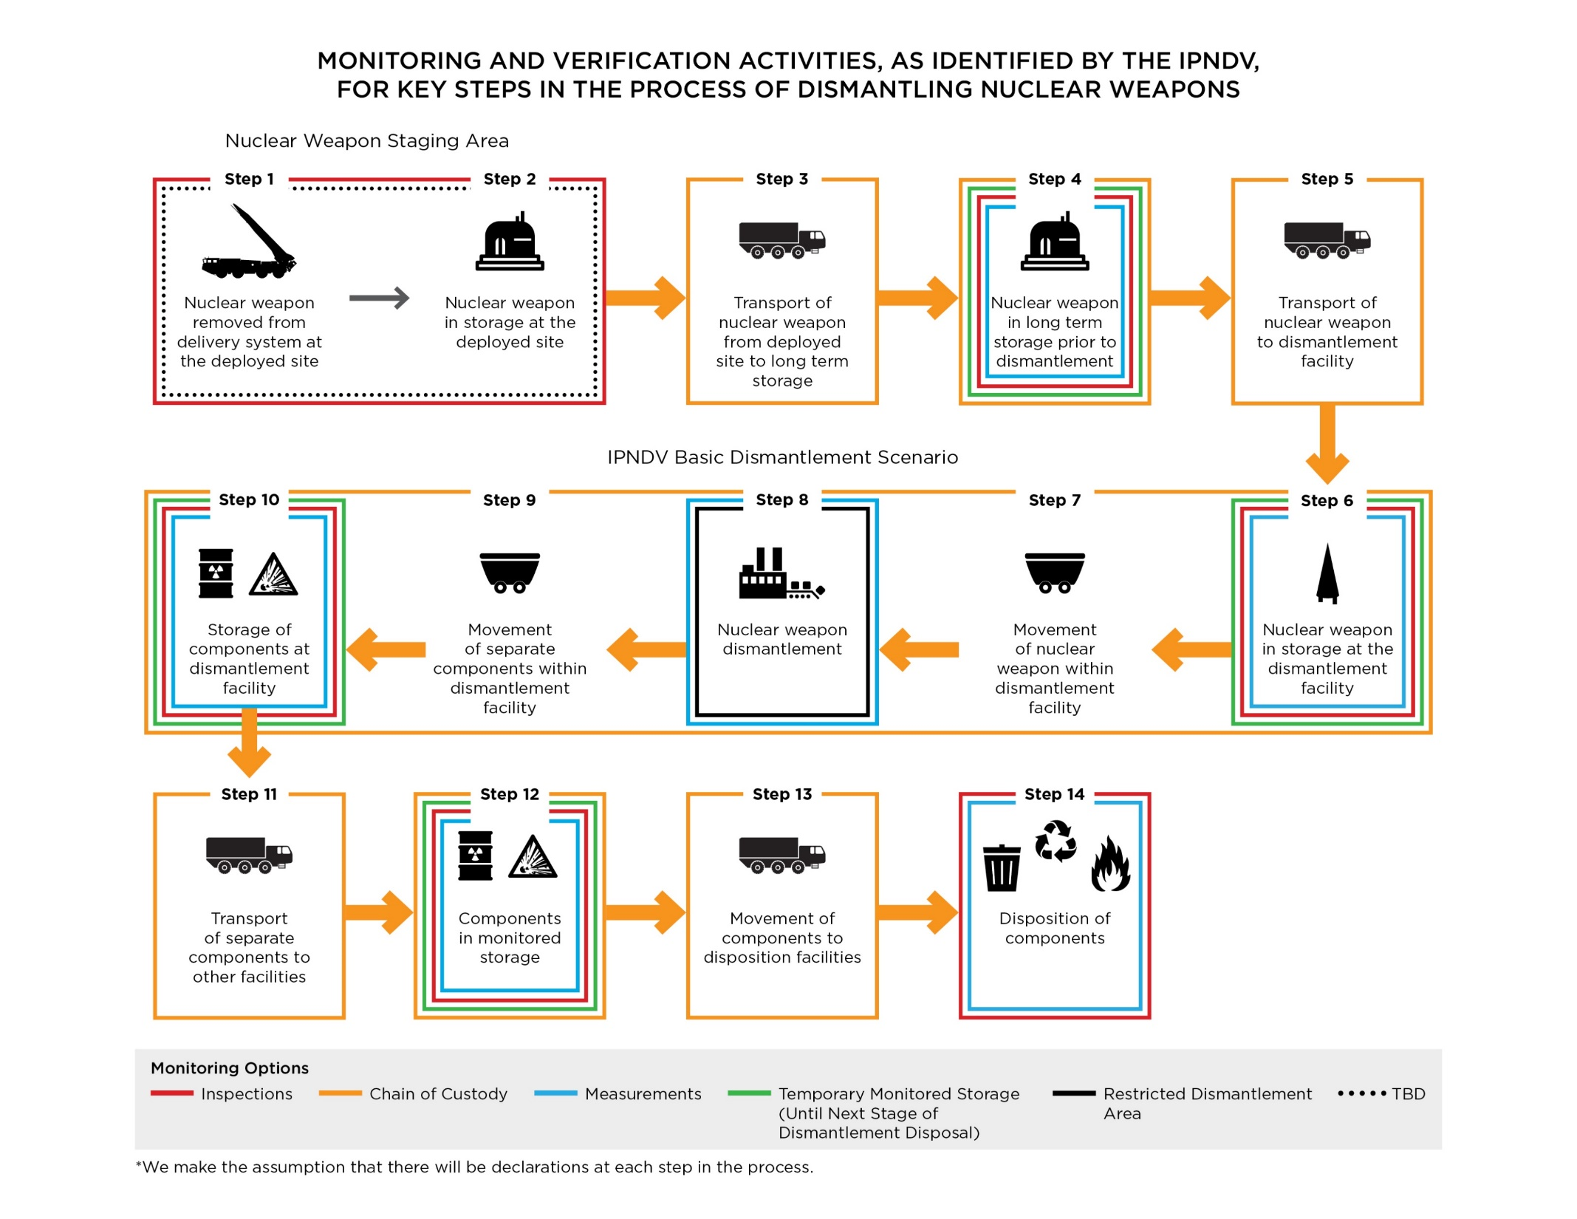
The 14 Steps: IPNDV’s Nuclear Weapons Dismantlement Lifecycle
Phase I addressed monitoring and verification activities in steps 6-10
Phase II addresses verification issues and technologies across the wider nuclear disarmament process
(all 14 steps)

Slide 8
Phase I Key Judgment
While tough challenges remain, potentially applicable technologies, information barriers, and inspection procedures provide a path forward that should make possible multilaterally monitored nuclear warhead dismantlement while successfully managing safety, security, non-proliferation, and classification concerns in a future nuclear disarmament agreement.

Slide 9
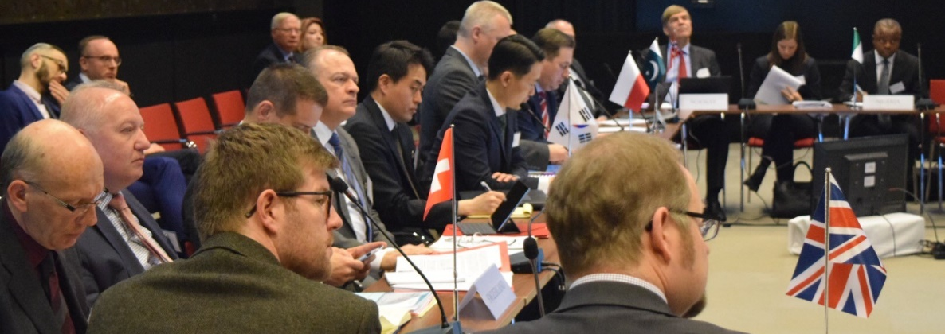
Phase II
Address verification issues across all 14 steps
Further assess technologies and procedures identified in Phase I to develop practical options
Engage with other experts and groups addressing nuclear disarmament verification challenges, including the United Nations Group of Governmental Experts on Nuclear Disarmament Verification (GGE)
Publish outputs ahead the 2020 Nuclear Non-Proliferation Treaty Review Conference (NPT RevCon)

Slide 10
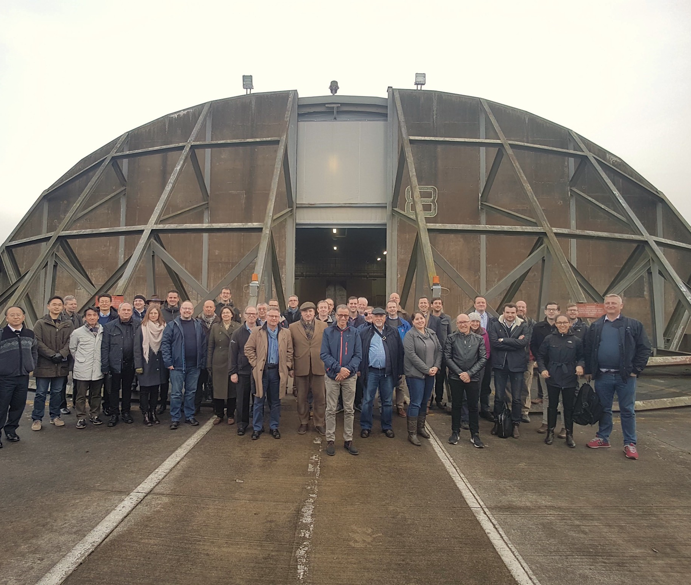
Beyond Phase II
The Partnership intends to continue its work on nuclear disarmament verification and monitoring beyond Phase II

Slide 11
Work Captured at ipndv.org
Phase I Summary Report
Walkthrough Exercise Summary Report
40 Working Group Reports and analysis products
Related resources collection
14-step dismantlement “lifecycle”
Digital interactive of basic dismantlement scenario
Event summaries, photos, and remarks
www.ipndv.org

