Slide 1
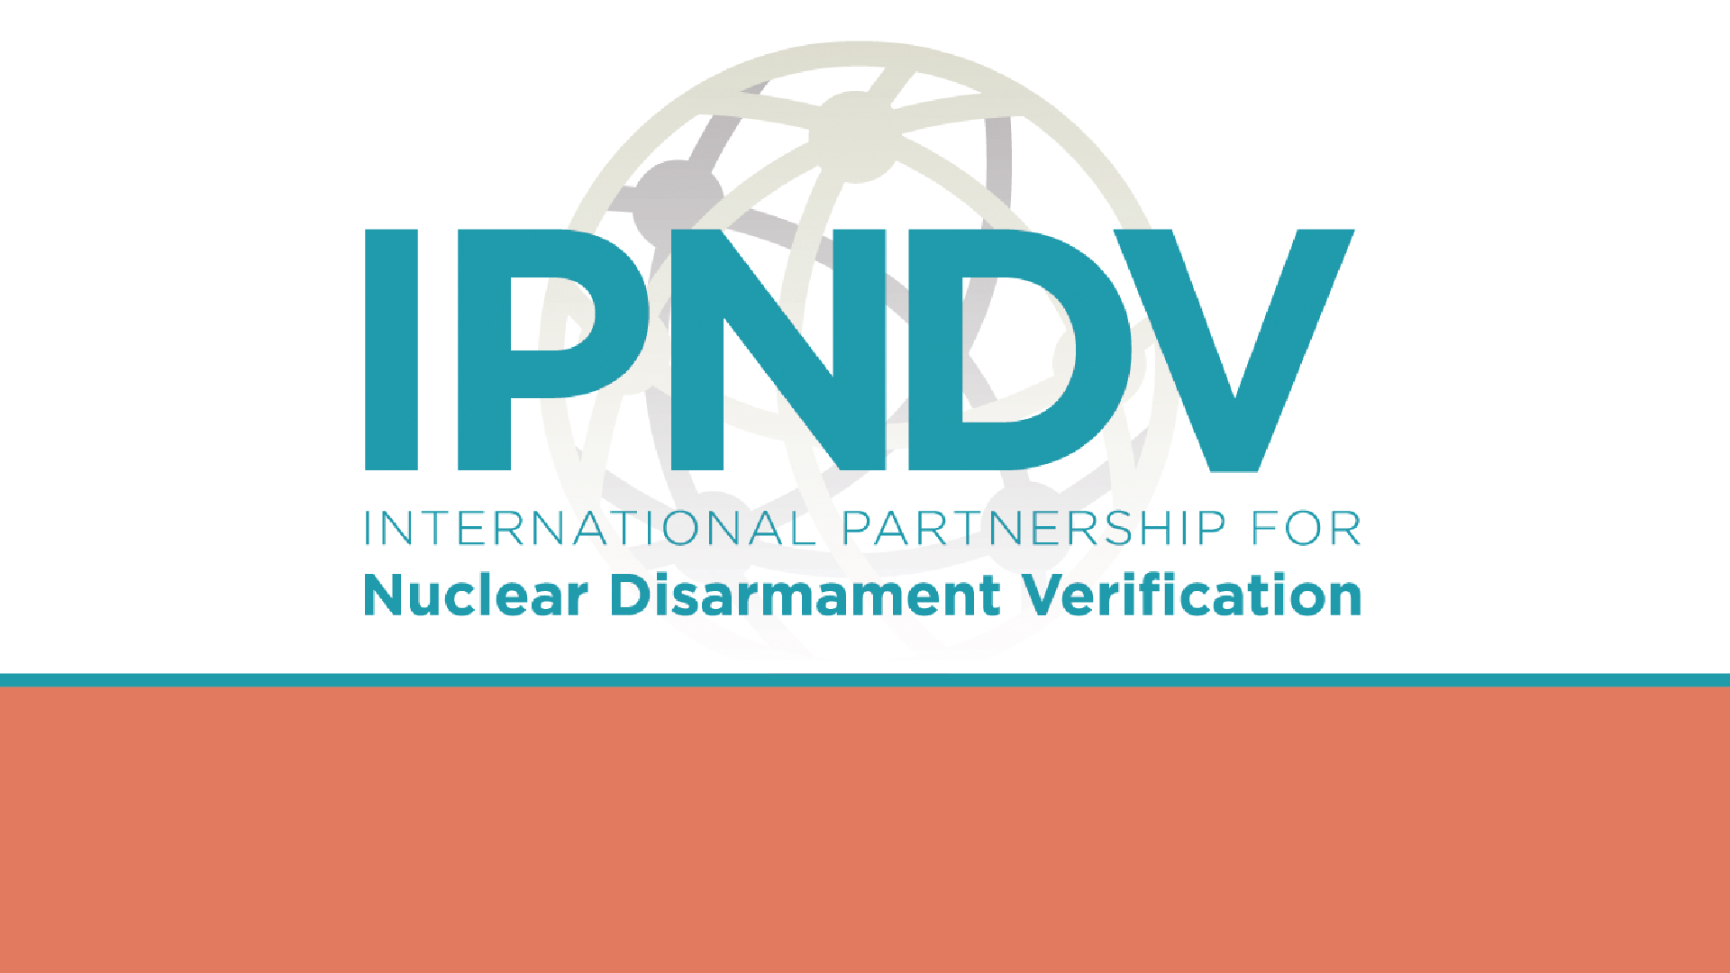
Verifying Future Nuclear Disarmament
Lessons from Five Decades of Arms Control and an Agenda for Readiness
Notes:
Show of hands of those who know about IPNDV

Slide 2

Past as Prelude: Verification Was Always the Hard Part
1
2
3
SALT/ABM Era
INF Treaty (1987)
START and Beyond
National Technical Means
The Inflection Point
A Living, Building Model
Verification relied on satellites and other intelligence gathering systems to watch large, fixed sites — silos and launch fields — with no inspectors on the ground.
NTM alone couldn’t confirm individual elimination of treaty-limited items. INF introduced the first intrusive on-site inspection regime: short-notice inspections, portal monitoring, and data exchanges.
Each treaty elaborated on the last. START’s central limits fit in a few paragraphs; its verification protocols ran nearly 350 pages.
The lesson: verification concepts that aren’t worked out before negotiations begin can become the slowest, most contested part of the negotiation process.

Slide 3
IPNDV Phase III: A Realistic Test Bed
The Initial Ipindovia Scenario
Three levels of verification objectives:
A notional Nuclear Weapons Reduction Treaty (NWRT) requiring the state of “Ipindovia” to cut deployed warheads from 1,000 to 500 — with full nuclear forces, bases, and depots modeled in detail.
1
Central Objectives
The treaty’s binding obligations — e.g., reduce to 500 warheads. Both sides share this goal.
Two added variants at the Phase III midpoint:
2
High-Level Objectives
A workable regime. Hosts add non-negotiable constraints: weapon safety, security, and protecting sensitive design information.
Limitations — arsenals capped at 500 warheads for a defined period
Reductions-to-zero — full elimination of arsenals
3
Implementation Objectives
Where divergence is sharpest: inspectors want broad access and notice; hosts want narrower declarations and managed access.

Slide 4
IPNDV Phase III: Changing Perspectives
The Host–Inspector Divide
Variations on a Theme
Understand how inspectors’ and host states’ perspectives differ — and where they align.
Understand how specific disarmament contexts shape distinct verification challenges.
1
Limitations Working Group
1
Inspector Task Group
Recurring inspection activities with steady-states nuclear weapons enterprise.
How to verify a state’s compliance.
2
Reductions Working Group
2
Host Task Group
Recurring inspection activities moving towards zero nuclear weapons
How to demonstrate compliance while ensuring safety and security.
3
Cross-Cutting Concepts Working Group
3
Technology Track
How to leverage common verification mechanisms across scenarios?
What technologies available/needed to effectively verify?
4
Technology Track
What technologies available/needed to effectively verify?

Slide 5
Lasting Impact of the IPNDV
10+ years of development
30+ countries engaged
Bridgeable, not insurmountable
A verification toolkit and conceptual frameworks now substantially more mature than a decade ago.
An expert community spanning both nuclear weapon and non-nuclear weapon states that did not exist before IPNDV.
Phase III’s decade of experience reinforces that multilateral disarmament verification is achievable.

Slide 6
An Agenda for the Future: Four Priority Areas
1
Concept Development and Refinement
2
Technology Assessment and Testing
Develop “plant-within-a-plant” inspection zones
Segregated warhead storage for chain of custody
Closeout and challenge inspections
Data security
Post-elimination verification
Advance HEU detection — the Technology Track’s hardest outstanding problem —
Information barriers
Tamper-indicating seals
Guardrails for AI-assisted monitoring
3
Realistic Validation Exercises
4
Building/Sustaining Global Capacity
In-person and focused tabletop, operationally realistic exercises:
Challenge inspections
Multi-site reductions-to-zero planning
Quad Chart framework under disruptive scenarios
Preserve the expert community IPNDV built through continued exercises
Build ties to the proposed GSTE
Annual stakeholder meeting spanning government, NGOs, and academia.

Slide 7
The Need for Future Readiness
The lapse of New START is exactly the kind of interlude history says we should use productively — not to wait for the next diplomatic opening, but to have the technical and conceptual groundwork already in place when it arrives.
Pre-developed, well-researched verification concepts don't eliminate uncertainty, but they give negotiators a crucial head start.
They create shared understanding of what is actually feasible to monitor and implement.
Verification work is among the most important elements of the arms control enterprise.
It's "blue collar diplomacy” that builds trust and cultivates habits of cooperation among experts, diplomats, and military establishments that outlast any single agreement.
Helps address the challenge of active research and development programs.
Future verification frameworks must account for new weapons technologies and modifications to existing systems as they emerge.
Cannot focus only on the systems that exist when negotiations begin; account for those already in the development pipeline and those still existing only in the minds of technical experts.

Slide 8
Questions?
Bridgeable
A verification toolkit and conceptual frameworks now substantially more mature than a decade ago.
An expert community spanning both nuclear weapon and non-nuclear weapon states that did not exist before IPNDV.

